Slide 1
Weekly Report
Pro. Huang && Shuo Zhang

Slide 2
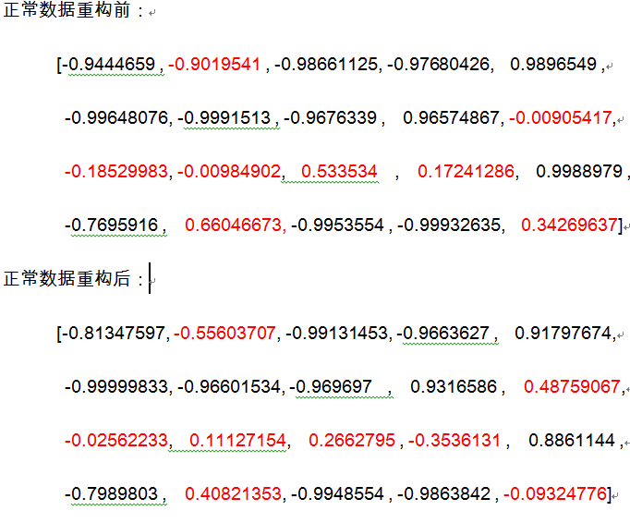
Problems

Slide 3
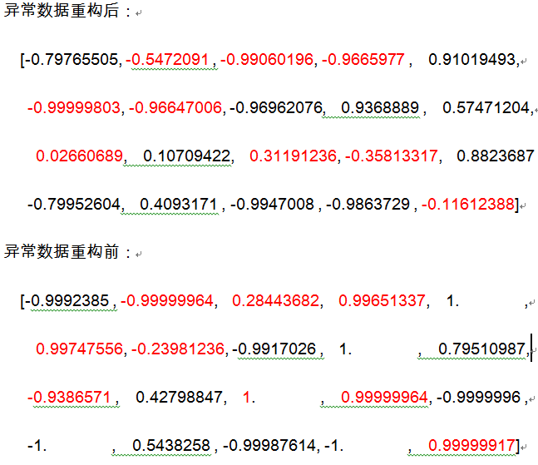
Problem

Slide 4
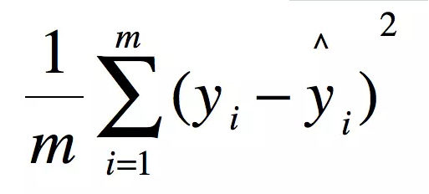
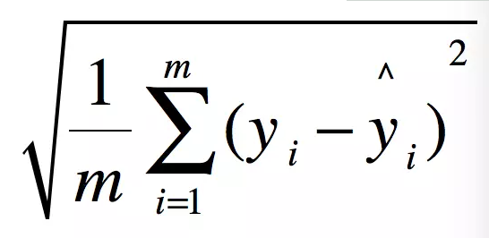
Analysis
MSE
RMSE

Slide 5
CNN-AutoEncoder
Notes:
COMPUTER SCIENCE, ARTIFICIAL INTELLIGENCE, Ⅰ

Slide 6
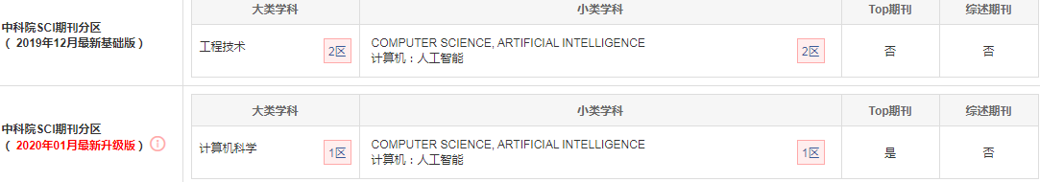
Detection and localization of myocardial infarction based on a convolutional autoencoder, Knowledge-Based Systems, 2019
Notes:
JCR COMPUTER SCIENCE, ARTIFICIAL INTELLIGENCE, 1

Slide 7
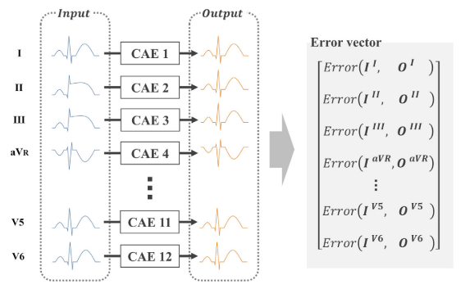
Network
Notes:
JCR COMPUTER SCIENCE, ARTIFICIAL INTELLIGENCE, 1

Slide 8
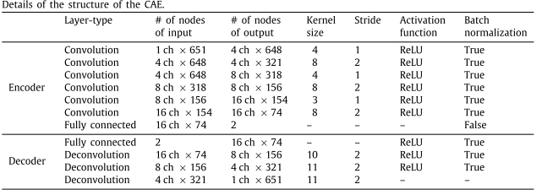
Network Details

Slide 9
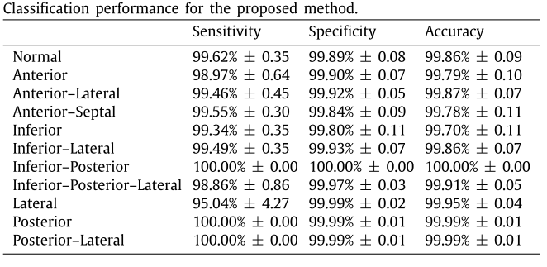
Result

Slide 10
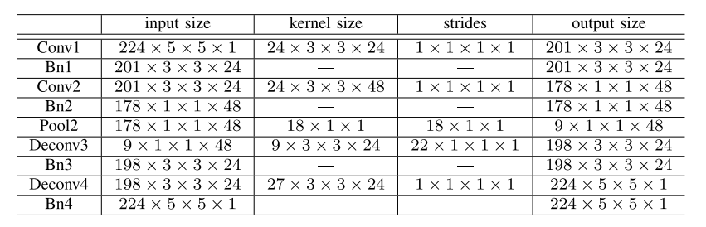
Comparison

Slide 11
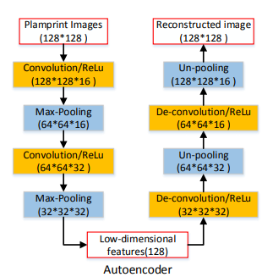
Comparison

Slide 12
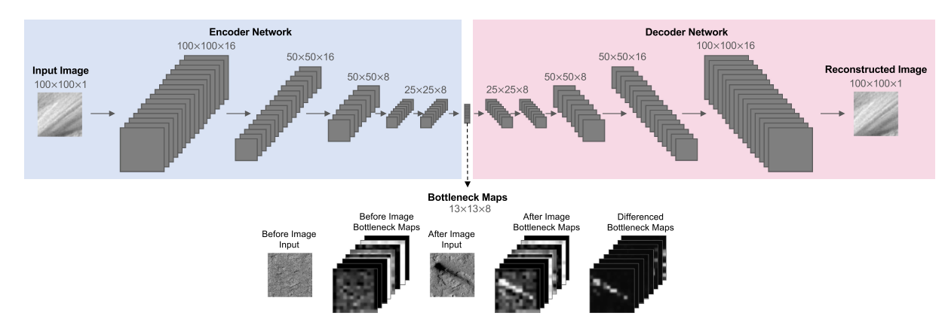
Comparison

Slide 13
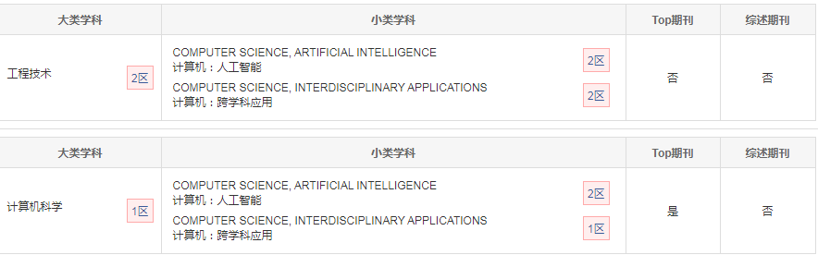
A spatio-temporal decomposition based deep neural network for time series forecasting, Applied Soft Computing, 2019
Notes:
JCR COMPUTER SCIENCE, ARTIFICIAL INTELLIGENCE, 1

Slide 14
Introduction
Moreover, convolutional layers can capture spatial and short-term patterns, but sliding a convolutional kernel on spatial features miss the underlying structure of the network and reduce the performance of the model.

Slide 15
Contribution
A multi-kernel convolutional layer is designed to maintain the network structure, and extract short-term and spatial patterns. It is followed by a convolution-LSTM component to capture long-term trends, and a pretrained denoising autoencoder to have robust prediction in the existence of missing data

Slide 16
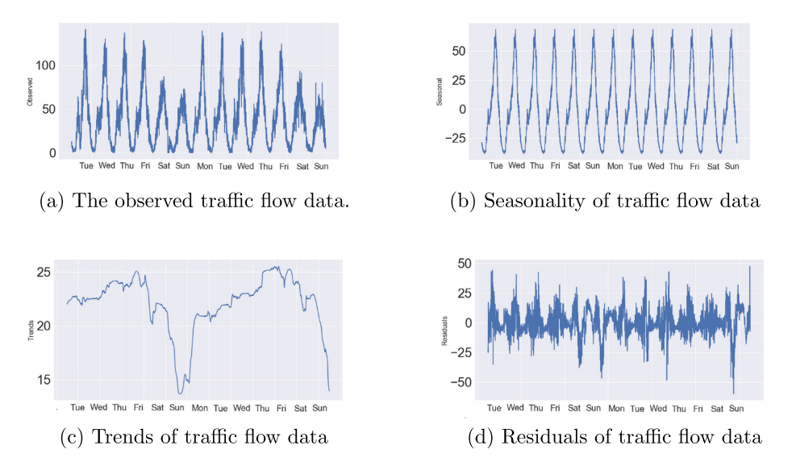
Experiment

Slide 17
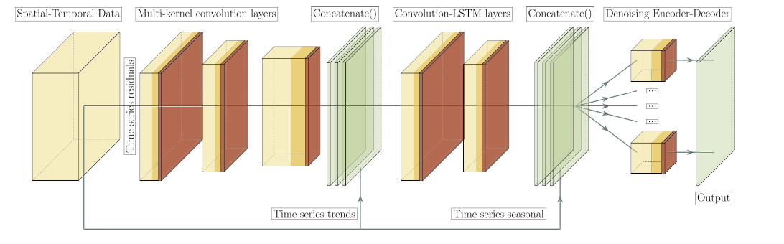
Network

Slide 18
A Particle Swarm Optimization-Based Flexible Convolutional Autoencoder for Image Classification, IEEE TRANSACTIONS ON NEURAL NETWORKS AND LEARNING SYSTEMS, 2019
The objective of this paper is to design and develop an effective and efficient PSO method to automatically discover the architecture of the flexible CAE (FCAE) without manual intervention.

Slide 19
Anomaly Detection

Slide 20
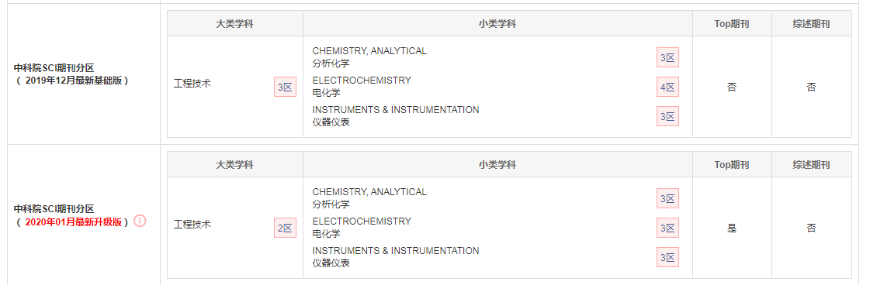
Fault Detection and Diagnosis Using Combined Autoencoder and Long Short-Term Memory Network, Sensors, 2019

Slide 21
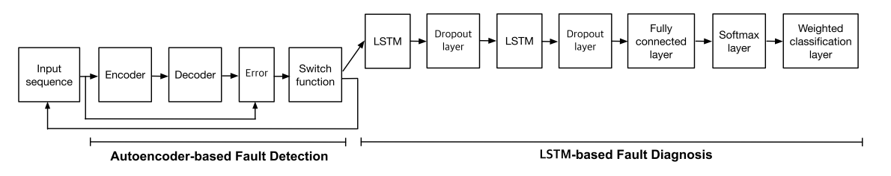
Network

Slide 22
Network
Instead of traditional parameter tuning using a backpropagation algorithm, we simply combine two trained models of both autoencoder and LSTM network where each model is separately trained. This approach has proven to be very efficient since it considerably improves the convergence rate of the overall structure with less numerical issue

Slide 23


Loss Function
Our target is not only to minimize the training error between the input xt and the reconstructed output ˆxt but also to address the overfitting issue with additional L2 regularization term of the weights.

Slide 24
Thanks
@MICC

